Slide 1
aChord (Hobby Project)
By Arbab Ahmed

Slide 2
Project Specification
A back-end application created using spring that at least performs CRUD on 2 tables
Front-end that show cases all the back-end API-end-points
Uses a cloud database
Version Controlling
Jenkins pipeline
Sonarqube
Testing

Slide 3
Technologies used
Springboot tool (JAVA IDE)
MySQL
Google cloud DB
jUnit Testing
Maven
Selenium Testing

Slide 4

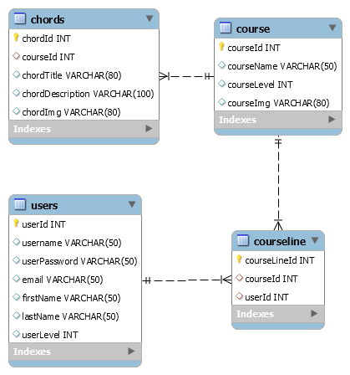
Back-end design

Slide 5
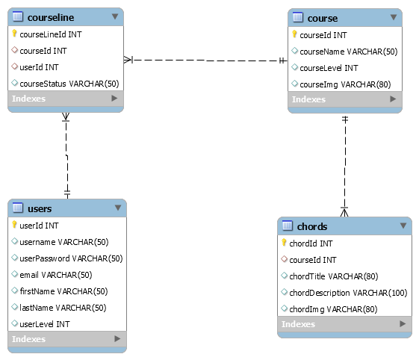
Back-end design

Slide 6
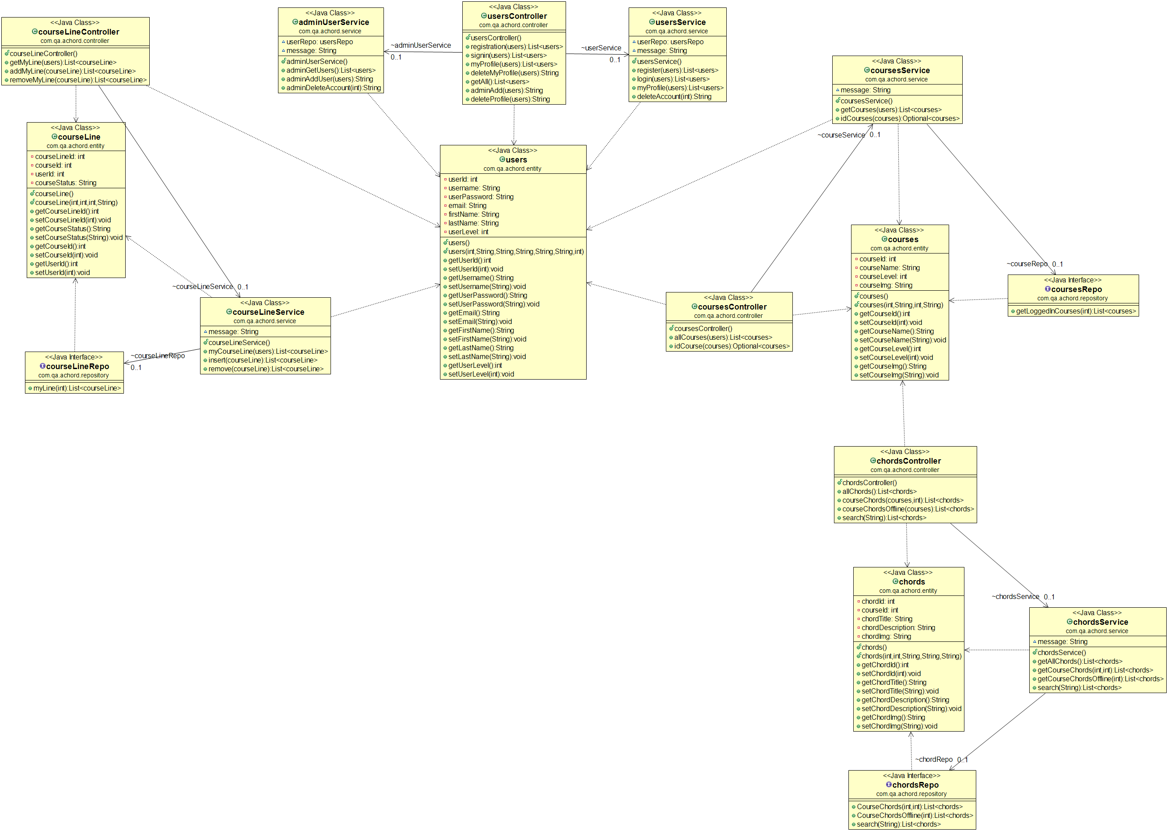
Back-end design

Slide 7
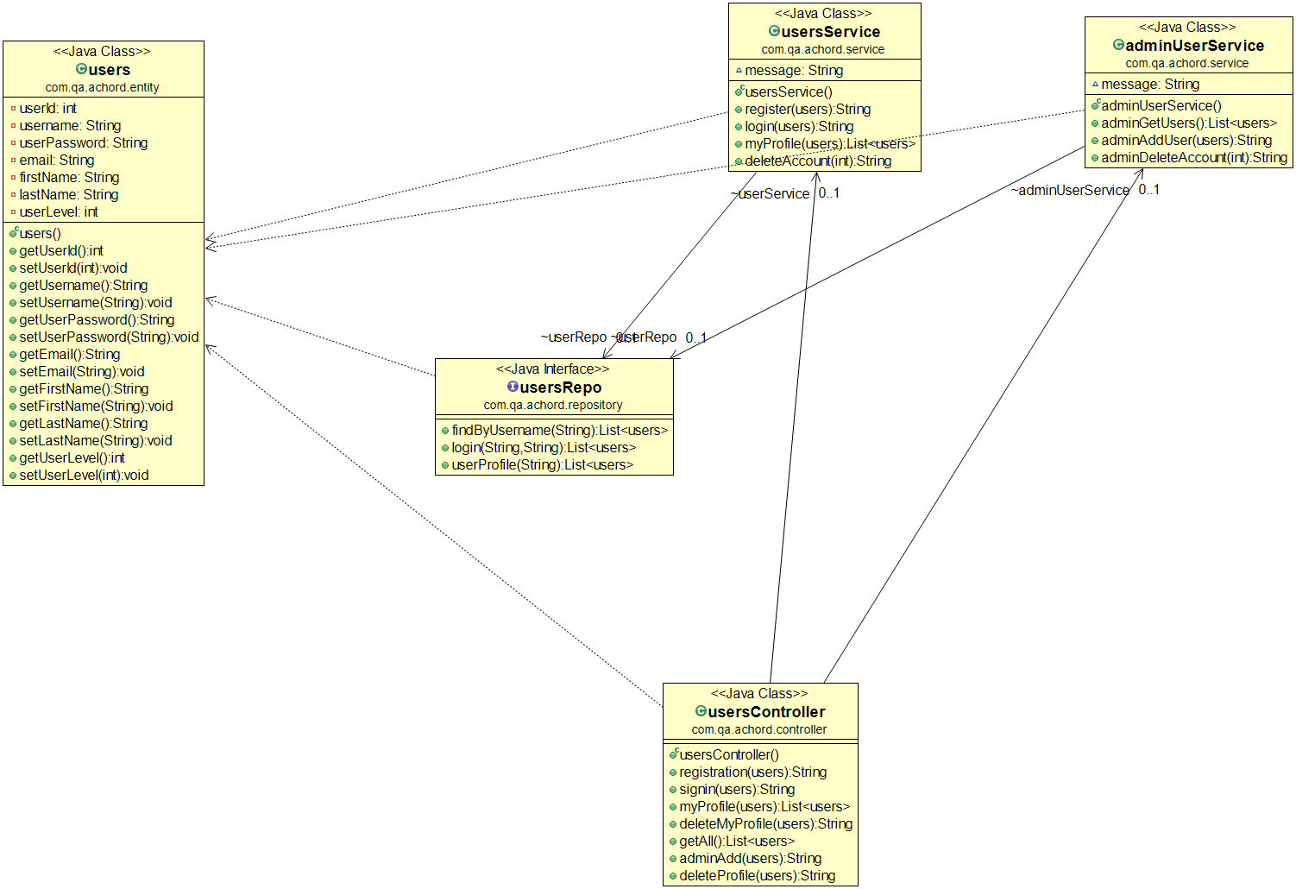
Back-end design

Slide 8
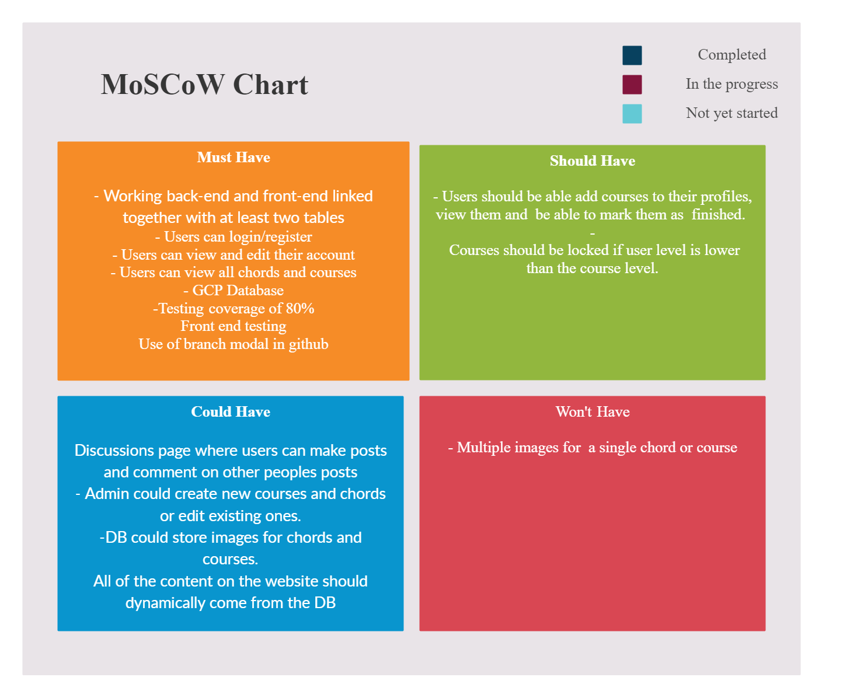
MoSCoW

Slide 9
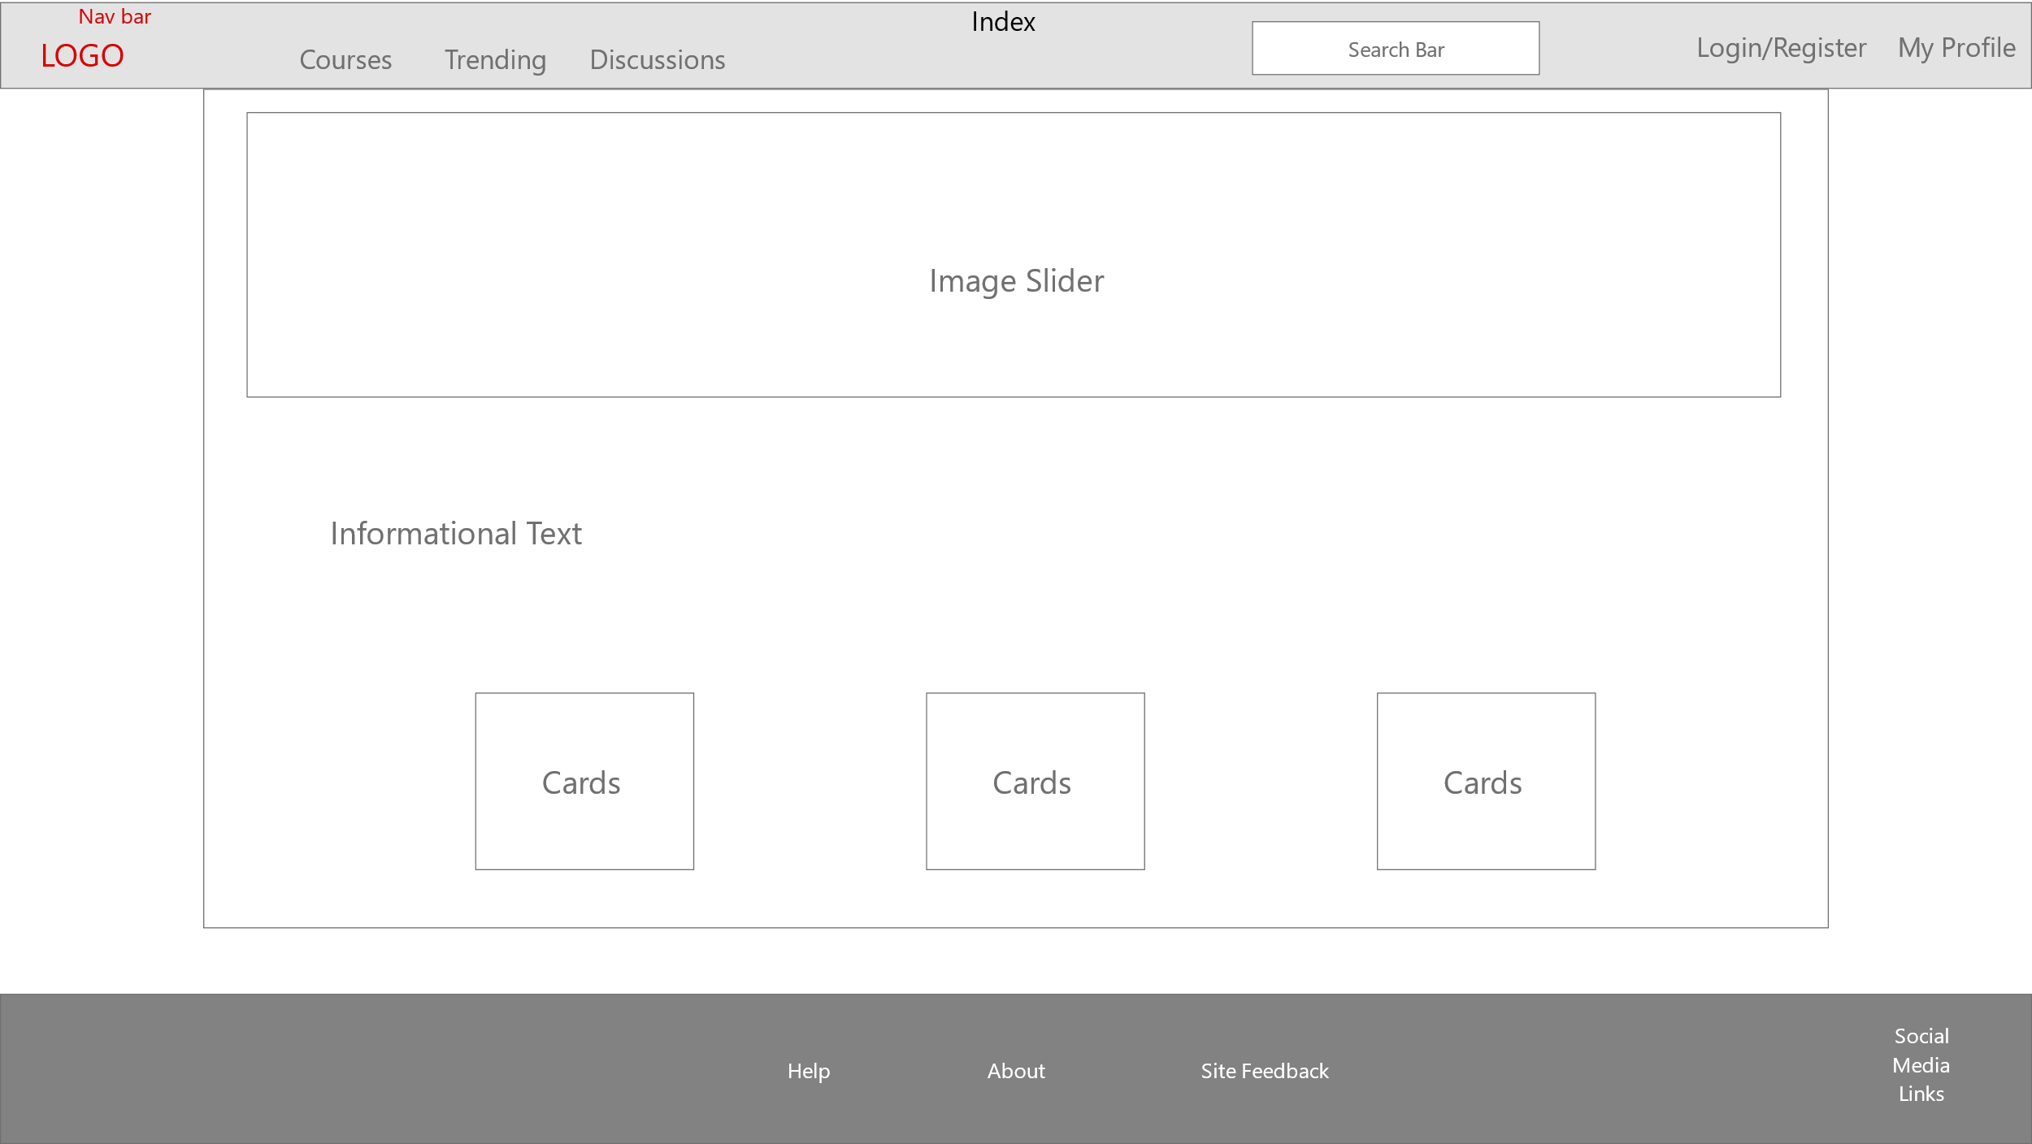
Front-end design (Index page)

Slide 10
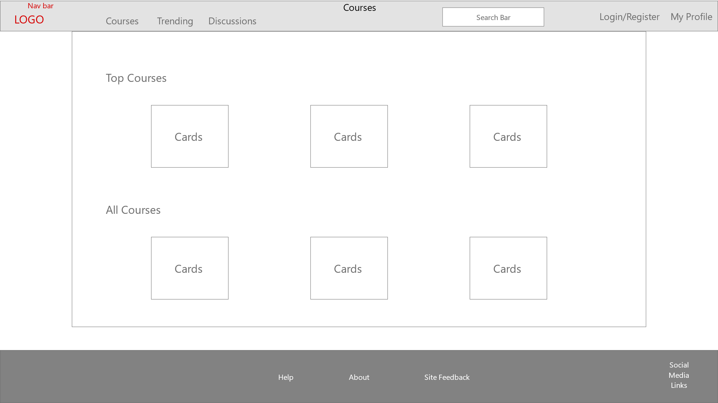
Front-end design (Courses page)

Slide 11
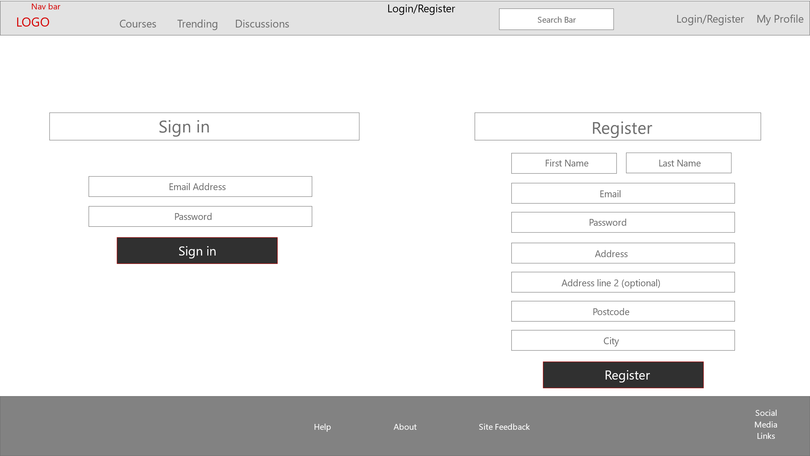
Front-end design (Sign in/up page)

Slide 12
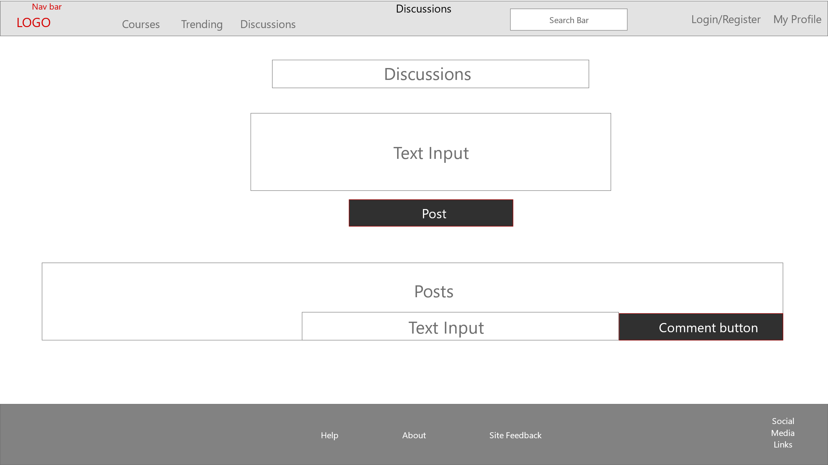
Front-end design (Posts page)

Slide 13
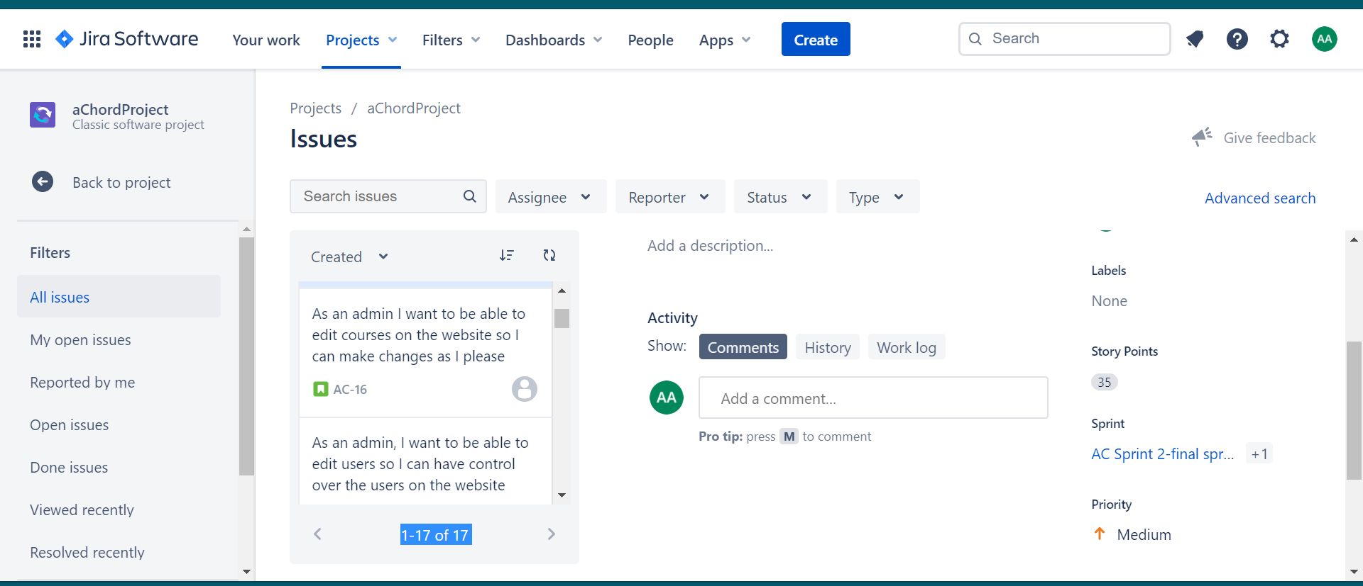
JIRA board For Project Management

Slide 14
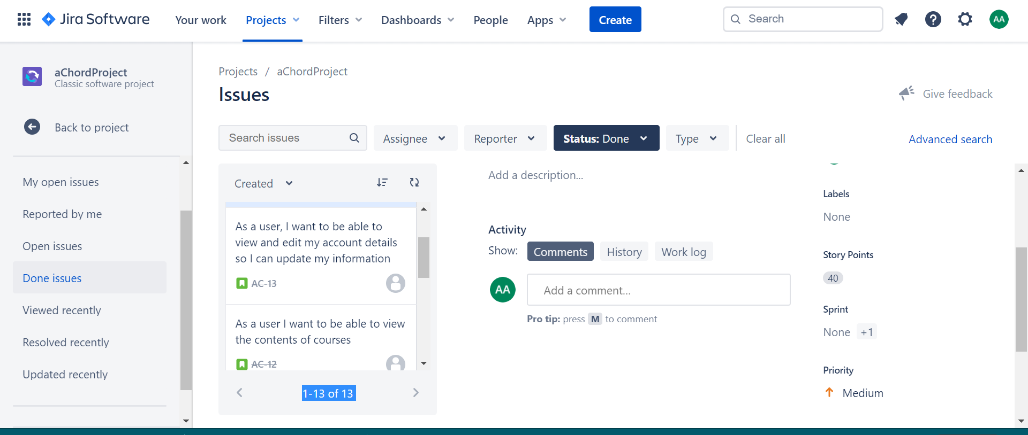
JIRA board Continued

Slide 15
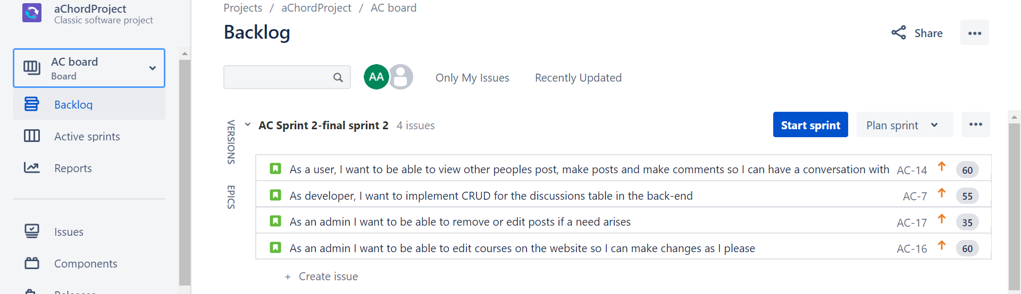
JIRA board issues not completed

Slide 16
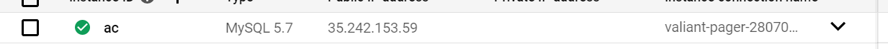
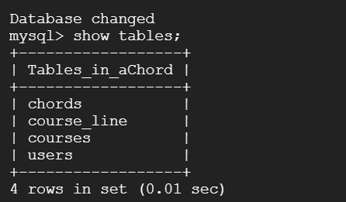
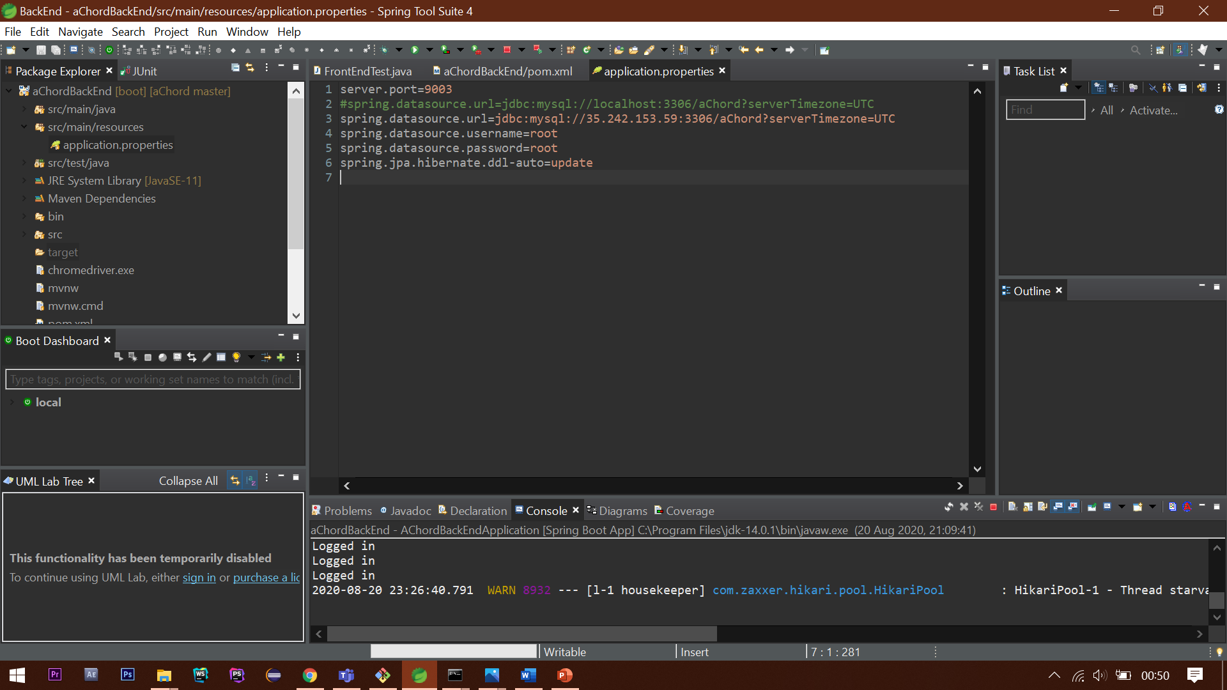
Google Cloud

Slide 17
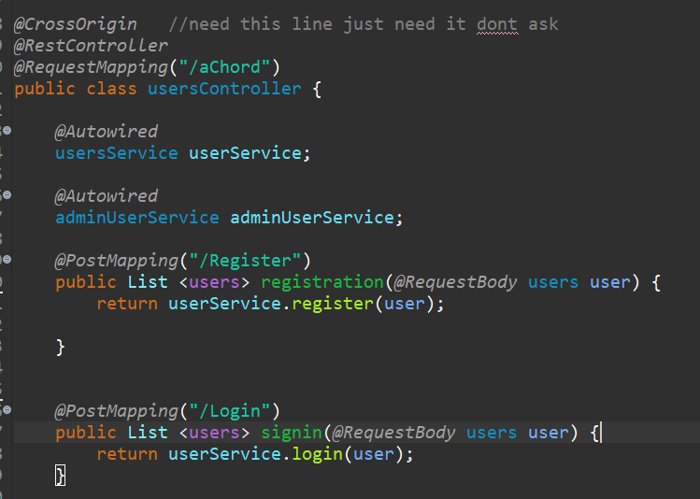
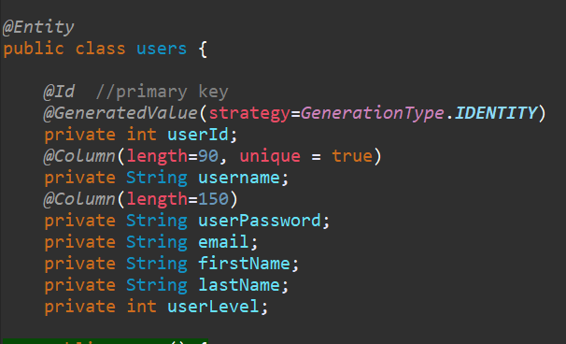
Back-end users-entity+controller

Slide 18
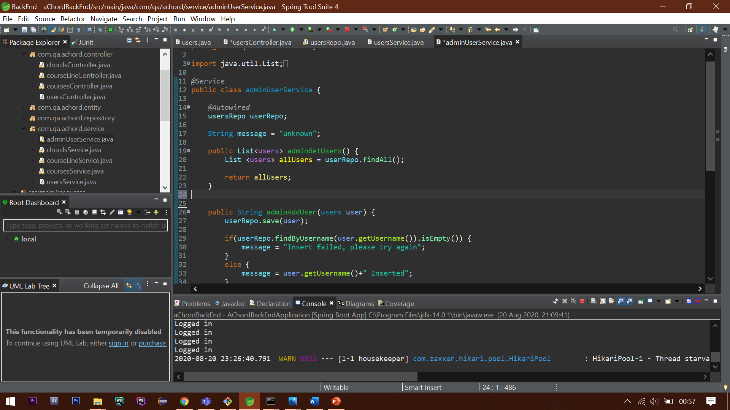
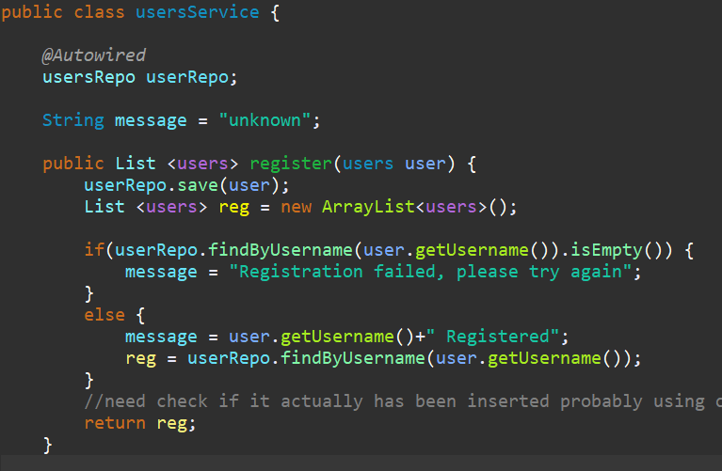
Back-end users-Service

Slide 19
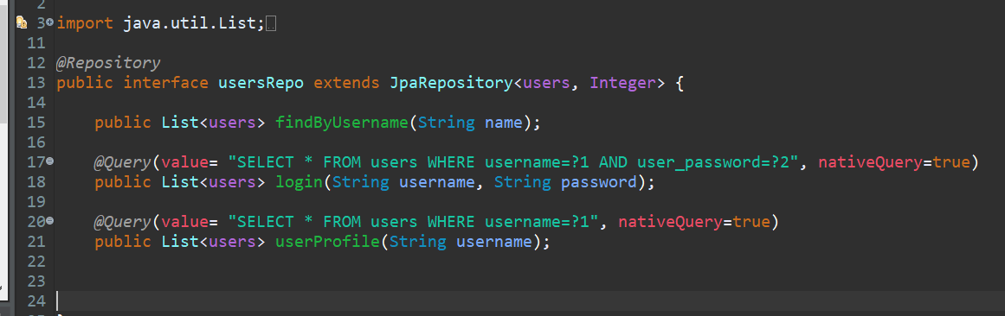
Back-end repo

Slide 20
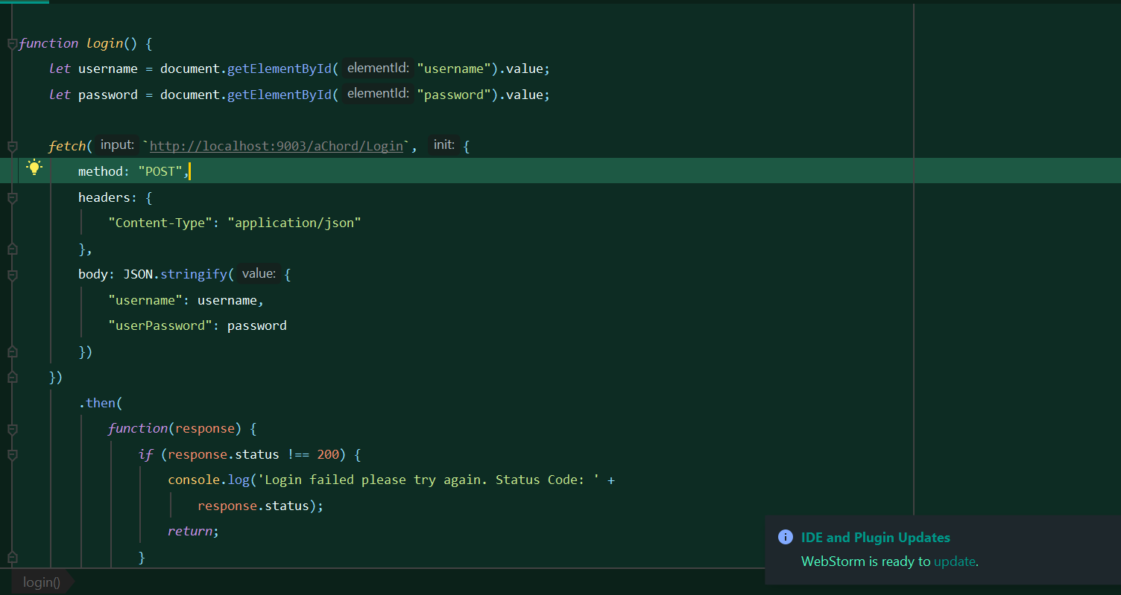
FrontEnd Implementation

Slide 21
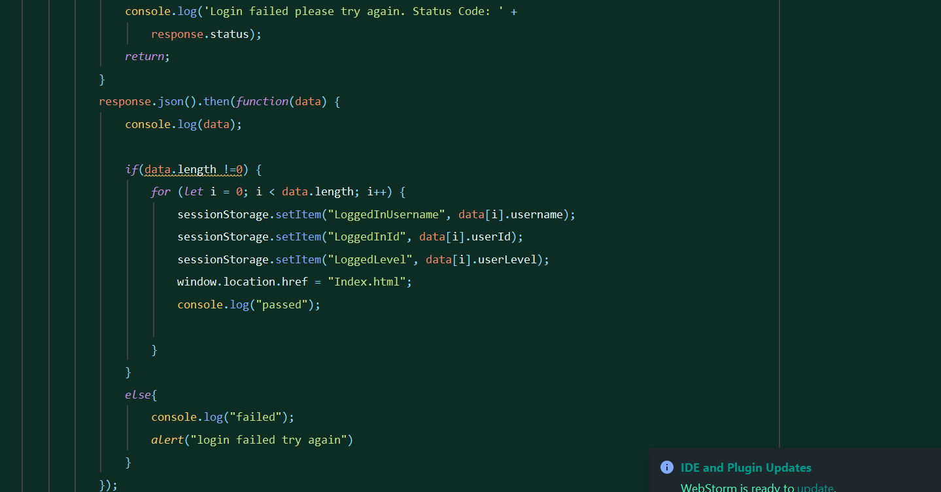
FrontEnd Implementation

Slide 22
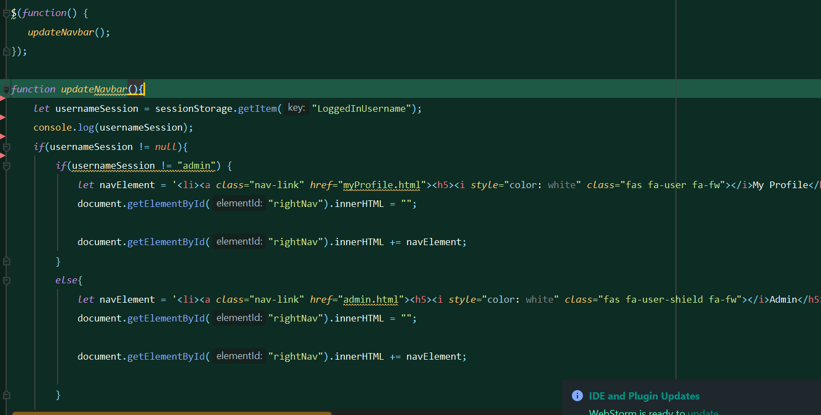
FrontEnd- Updating Navigation bar

Slide 23
Testing

Slide 24
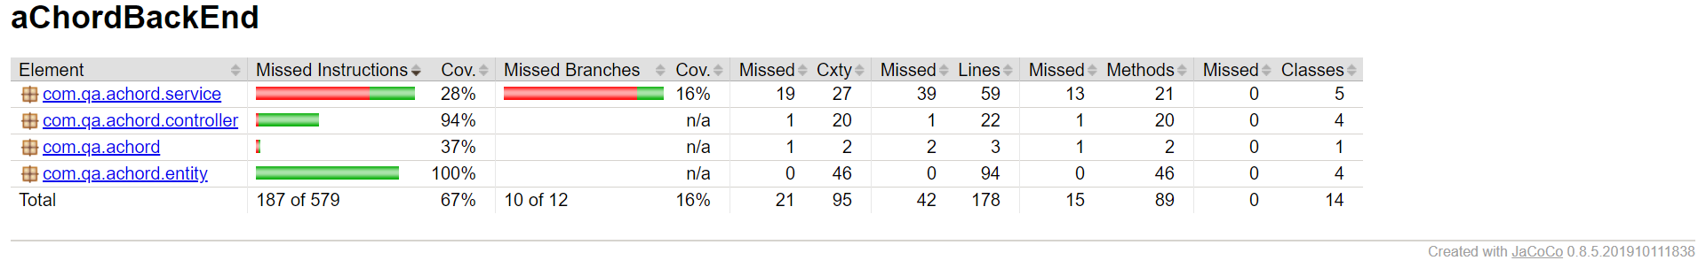
Test Coverage

Slide 25
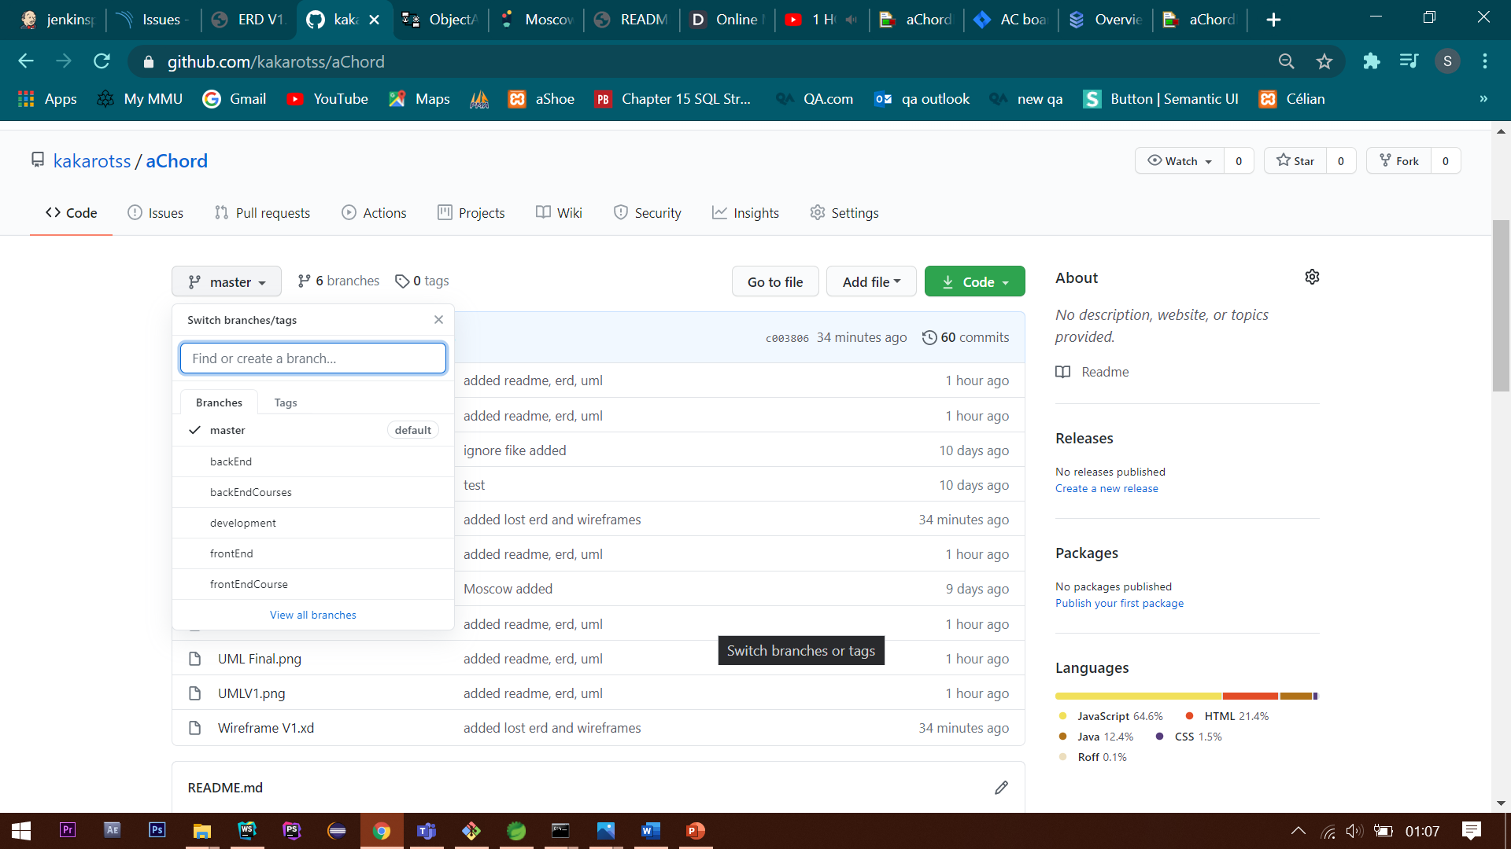
Version Control System (GitHub)

Slide 26
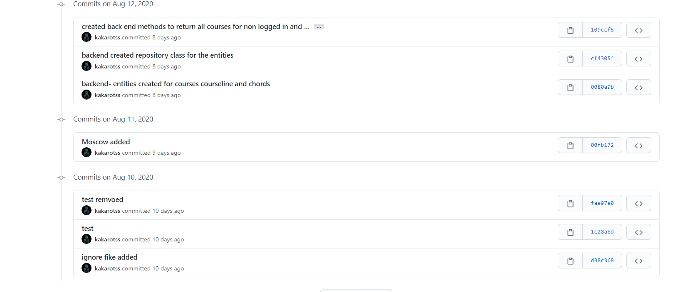
Commits

Slide 27
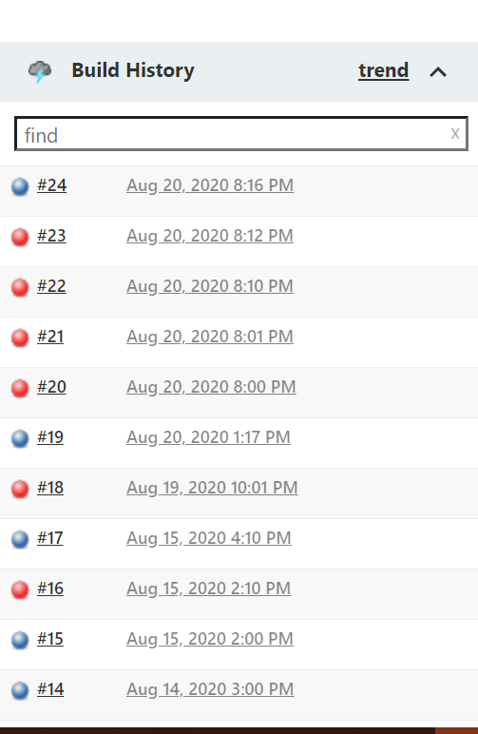
Jenkins

Slide 28
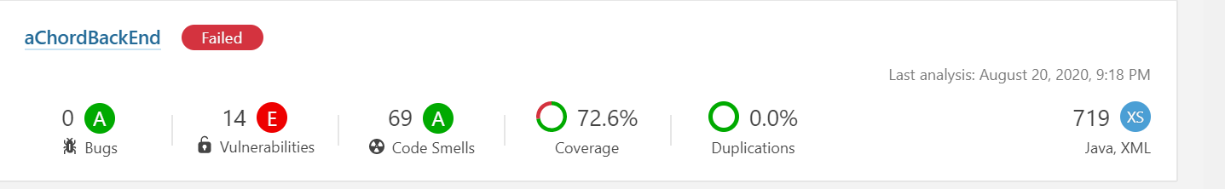
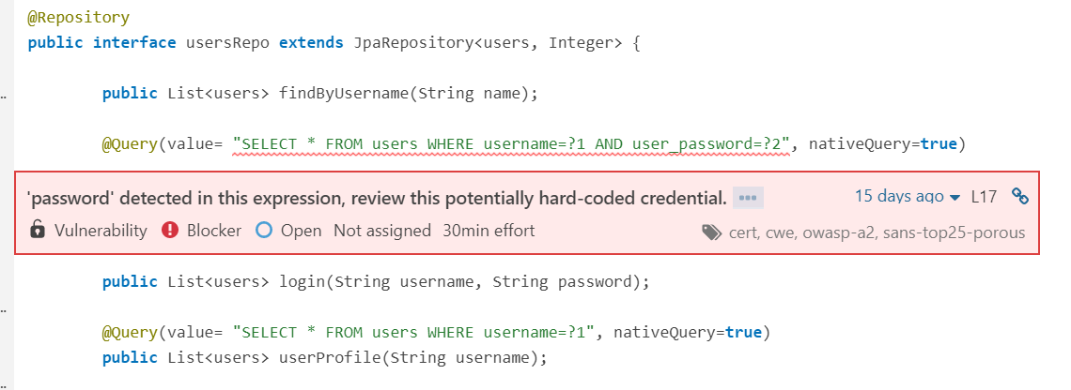
Sonarqube

Slide 29
Unimplemented features and Problems
Unimplemented
Admin Control Options for courses, courseLine and chords tables
Functionality for discussions page
Problems Faced
Errors with Jenkins
Errors with GCP
Errors with Testing
Front End testing issues

Slide 30
End of Presentation Thank you for Listening

